Slide 1
Time lapse photo collection
M. Ali Yousuf
All images copyrights to its owners
Collected using Google search: “sports time lapse”

Slide 2
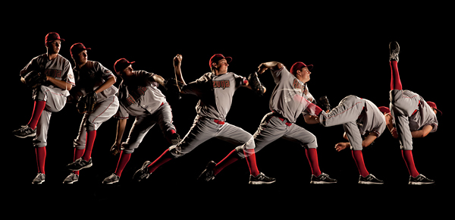
https://foliofox.files.wordpress.com/2011/09/roahdh.jpg

Slide 3
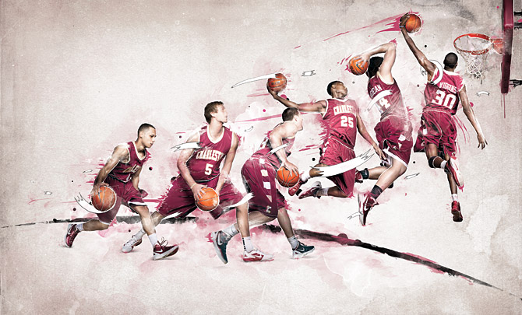
http://abduzeedo.com/node/74482

Slide 4
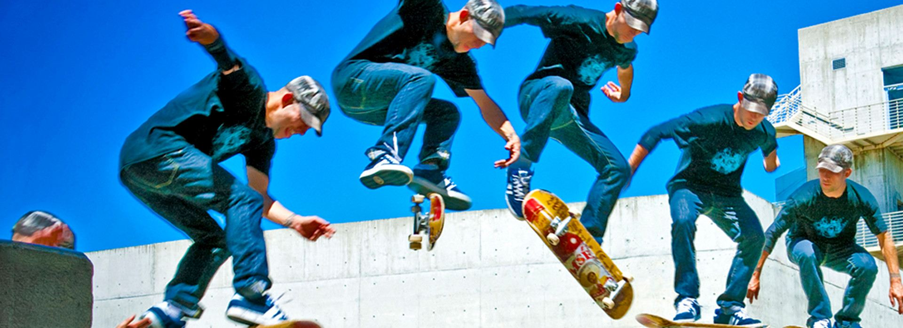
https://www.prodad.com/Slowmotion-Timelapse/ReSpeedr-V1-29772,l-us.html
Note: They also have a software (free trial): proDAD ReSpeedr V1: The Ultimate Super Slow-motion & Time-lapse Video
Producer Create stunning time-lapse and super slow-motion sequences. Professional grade results without the
professional price tag.

Slide 5
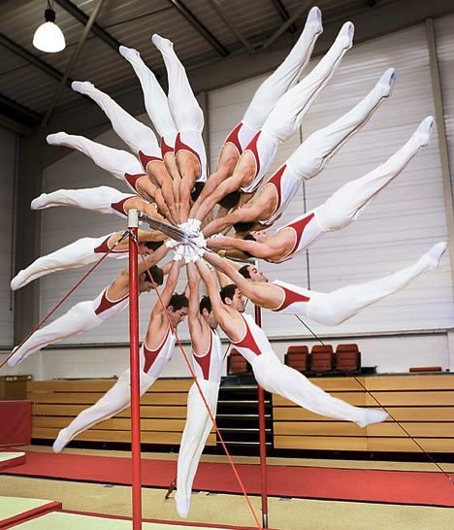
https://www.pinterest.com/pin/95420085828385619/

Slide 6
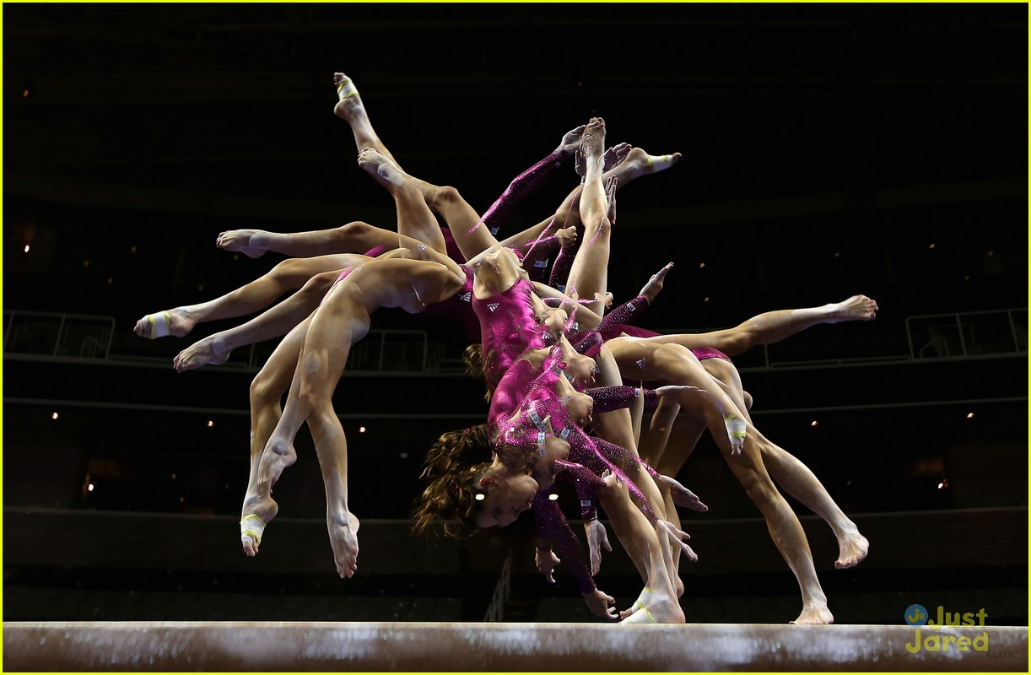
http://www.justjaredjr.com/photo-gallery/480360/us-olympics-gymnastics-women-2012-04/

Slide 7
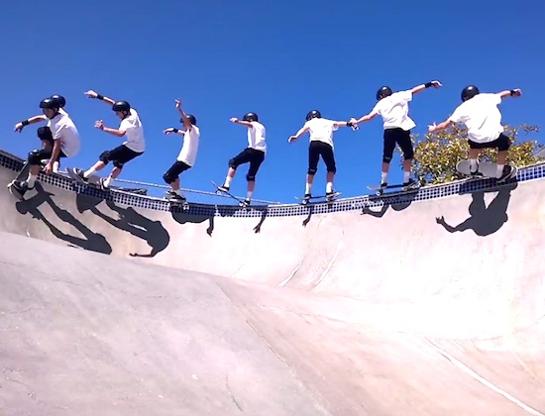
http://dailyurbanculture.com/awesome-60-different-clips-of-time-lapse-video-of-pool-skater/

Slide 8
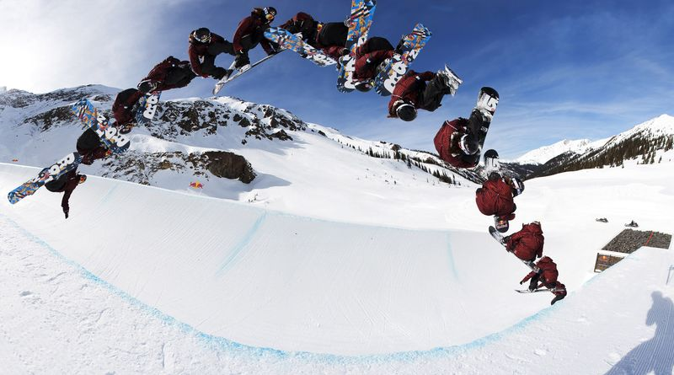
http://americanhistory.si.edu/blog/2012/02/snowboarding-shreds-into-the-smithsonian.html

Slide 9
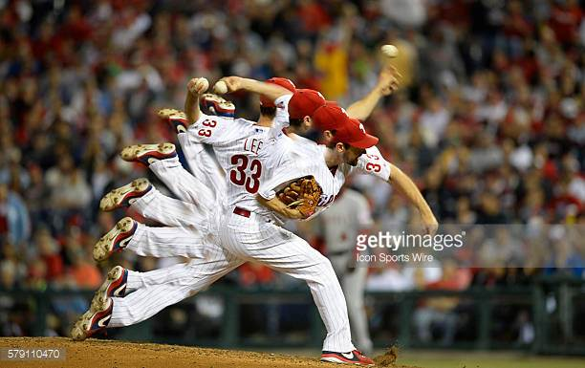
https://www.google.com/url?sa=i&rct=j&q=&esrc=s&source=images&cd=&cad=rja&uact=8&ved=0ahUKEwj5lqfApYfYAhXhhOAKHQOcDoEQjRwIBw&url=http%3A%2F%2Fwww.gettyimages.com%2Fphotos%2Fsports-time-lapse&psig=AOvVaw26WISOGGZ0rioC0oVJLXQN&ust=1513261992729938

Slide 10
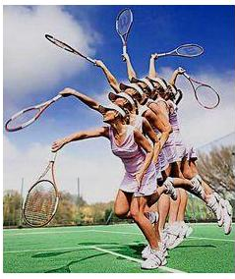
https://www.sportpartner.co.uk/blog/learning-how-to-time-your-serve

Slide 11
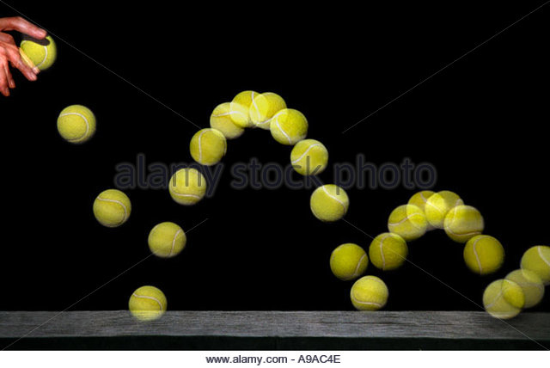
http://www.alamy.com/stock-photo/tennis-ball-time-lapse.html

Slide 12
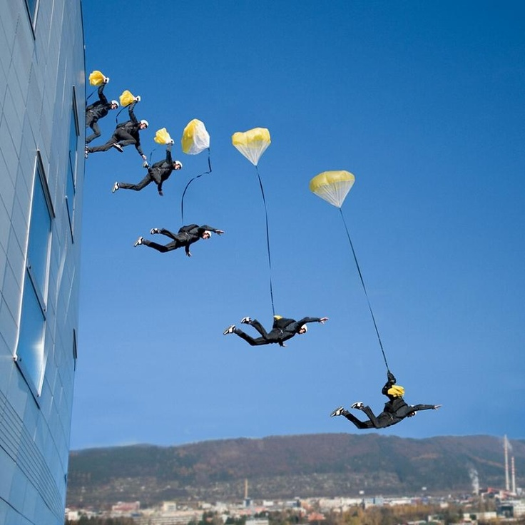
https://www.pinterest.com/beakymcgee/time-lapse-photos/

Slide 13
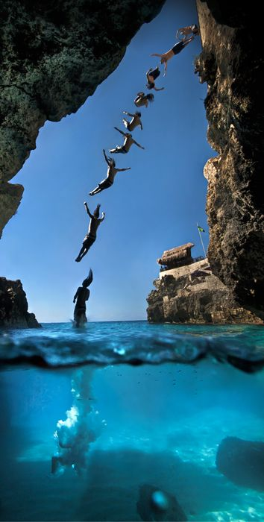
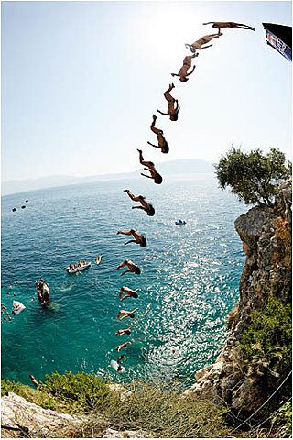
https://www.pinterest.com/beakymcgee/time-lapse-photos/

Slide 14
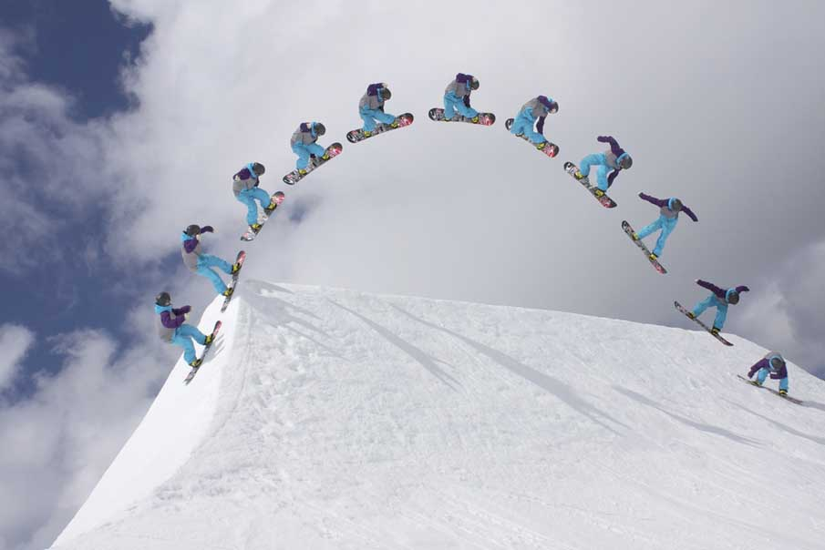
Many more here:
http://www.pxleyes.com/blog/2012/03/50-brilliant-examples-of-sequence-photography/

